Slide 1
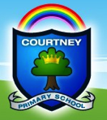
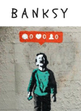
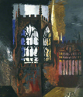
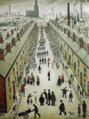
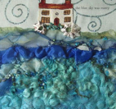
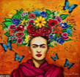
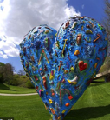
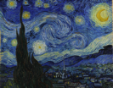
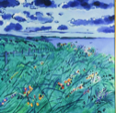
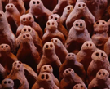
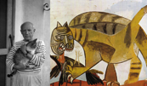
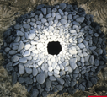
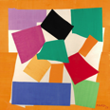
Hundertwasser: Drawing
colour mixing
Printing
pattern
pastels
The Courtney Primary School
Art Learning Journey
I am an Artist
…and when I am an Artist anything is possible. I am inspired, excited and challenged by Artists from across the world and the art that I create. My art helps me to express myself, experiment and take risks that challenge me to be creative. As an artist, I feel free to say what I think and be the unique, amazing individual that I am. My art can take me anywhere in the world. It makes me feel happy and relaxed because I am engrossed in my work, which allows me to explore my imagination and the world around me. I know that art can help me understand who I am, other people and the world.
I know that Art is important. It is a form of communication and expression that has existed since pre-history. It tells stories and helps us comment on and understand the world that we live in. It brings joy, creativity and can influence our views and thoughts… it is a language that gives us a deeper insight into what it means to be human.
At Courtney, children will encounter and learn from 3 real artists every school year. Over time they will encounter and revisit drawing, painting, textiles, print and 3D skills. They will develop their own ideas while considering line, colour, shape, form, texture, balance and proportion in different media. There will be an annual exhibition of their work.
Banksy, an artist from Bristol, will inspire the children to make a comment about the culture/society we live in using stencil techniques.
John Piper is an architect. By learning about perspective techniques to create space, paint and resist, children will create their own work based on where they live.
Louise Bourgeois is a French, female sculptor. Children will explore form using drawing techniques in charcoal, including negative space, before creating a sculpture from wire and Modroc. This could be a large scale sculpture.
Yelanna James explores organic, tangled shapes in pen, inks and markers. Children will be inspired by her work to create batik/silk painting.
6
YEAR
Lowry depicted the industrial world in which he lived. Through perspective drawing and painting, children will use the 5 colours he used to depict their own surroundings in his distinctive style.
James Ort is a ceramicist. Children will observe and draw in a variety of media before exploring the form of animals in wire and clay.
YEAR
Carolyn Saxby is a Textiles artist from
St Ives. Children will learn how to felt and explore texture.
5
Eric Joyner. Children will learn how to draw using one point perspective and how to create space using colour and tone.
Mark Hearld is an illustrator and printmaker. Children will learn about plant and animal form, before creating Lino prints in his style.
Giacometti. Children will draw the human form using free mark making in charcoal and inks before creating a wire and modroc sculpture .
Frida Kahlo: Children will learn about this female, Mexican artist. They will learn about proportion, line and colour theory when creating their own portrait in her style.
Jim Dine. Children will learn that art can tell a personal story through this American pop artist. They will explore texture and form creating a
sculpture in
clay.
YEAR
In Year 3-6, children are taught how to explore, annotate research ideas using a sketchbook. Larger work is collected in a folder.
4
Eric Cremer: Working in wood, card and paint, children will explore texture, shape and space when creating their sculpture.
Learning from Van Gogh’s Starry Night, the children will create their own Intaglio prints and combine this with fluid painterly brush strokes in the style of Van Gogh.
Phillip Sutton. Learning from this British artist, children will develop expressive drawing/mark making skills using sticks and ink. They will develop understanding of colour mixing and composition/balance. Inks and Acrylic paints will be investigated to create a final piece.
YEAR
3
Pablo Picasso.
Children will create angry cats, comparing observational drawing with free mark making in charcoal and white chalk. They will add newspaper collage to create a mixed media effect.
YEAR
Anthony Gormley. Children will explore form through drawing with different media and sculpting with clay
2
Judy Watson.
Learning from this aboriginal, female artist, children will explore pattern, colour and line using different media. They will create their own or collaborative response on fabric using cold Batik.
Wassily Kandinsky. Children will explore line, shape and marks using different media like pastels and charcoal. They will incorporate printing.
Andy Goldsworthy. Children will explore colour, shape and form in nature using printing and sculpture.
Henri Matisse.
Children will explore mixing colour creating their own paper. They will collage considering shape, pattern, colour and balance.
YEAR
1
RRR
Examples of work are collected in a large folder and with photos.
EYFS
Cultural Capital: is the essential knowledge (and skills) that pupils need to be educated citizens, introducing them to the best the has been thought, (created) and said and helping to engender an appreciation of human creativity and achievement.

Slide 2
Hundertwasser: Drawing
colour mixing
Printing
pattern
pastels
The Courtney Primary School
Art Learning Journey
Key stage 3
Pupils should be taught to develop their creativity and ideas, and increase proficiency in their execution. They should develop a critical understanding of artists, architects and designers, expressing reasoned judgements that can inform their own work.
Pupils should be taught:
to use a range of techniques to record their observations in sketchbooks, journals and other media as a basis for exploring their ideas
to use a range of techniques and media, including painting
to increase their proficiency in the handling of different materials
to analyse and evaluate their own work, and that of others, in order to strengthen the visual impact or applications of their work
about the history of art, craft, design and architecture, including periods, styles and major movements from ancient times up to the present day.
At Courtney, children will encounter and learn from 3 real artists every school year. Over time they will encounter and revisit drawing, painting, textiles, print and 3D skills. They will develop their own ideas while considering line, colour, shape, form, texture, balance and proportion in different media. There will be an annual exhibition of their work.
KS3
Banksy
Stencil
printing techniques
John Piper
Paint mixing
colour theory
perspective drawing
Louise Bourgeois
Metal sculpture
Larger scale
Milestones Year 6
I am exploring real artists’ work and making links to my art.
My sketchbook allows me to experiment, explore, record, & play with art techniques and media.
I can record and annotate ideas, thoughts and photos. I write about my work to share my ideas.
I understand that art can express a social/political message.
I am able to make a stencil and use spray paint as a resist technique like Banksy.
I can mix colours of a variety of tones and qualities like John Piper.
I can build up colour and marks over a series of lessons.
I can use colour science to help me create impact.
I am mastering the use of a paint brush.
I am able to work on a larger scale inspired by Louise Bourgeois.
6
YEAR
Yelanna James
Textiles techniques
Lowry
Perspective drawing
5 colour paint mixing
James Ort
Wire & clay sculpture
Sketching.
Milestones Year 5
I am exploring real artists’ work and making links to my art.
My sketchbook allows me to experiment, explore, record, and play with techniques and media.
I can record and annotate ideas, thoughts and photos, and write about my work to share my ideas.
I can sketch from direct observation and to develop a design.
I can manipulate wire and clay to create inspired by James Ort.
I can draw using 1 point perspective.
I can mix colours like Lowry.
I continue to master ideas about composition so my colours, shapes and lines work well in 2D.
I use Silk Painting to explore pattern and resist techniques similar to Yelena James.
YEAR
5
Mark Hearld
Printing
Drawing/sketching
Jim Dine
Clay sculpture
Eric Joyner
Perspective
Painting techniques
Giacometti
Wire sculpture
Expressive drawing
Frida Kahlo
Drawing, proportion
Colour mixing / science
Carolyn Saxby
Textile techniques
Milestones Year 3
I am exploring real artists’ work and making links to my art.
I am able to use sculptural clay techniques to express my memories and emotions; Jim Dine
I can create texture in different ways.
I can draw using 1 point perspective, creating 3D robots and depth; Eric Joyner.
I can carefully control my paintbrush and blend different tones of paint by adding white.
I am developing print techniques, relief mark making, with Lino/Styrofoam; Mark Hearld
My sketchbook allows me to experiment, explore, record & play with techniques and media.
I can record and annotate ideas to share my ideas and experiences using stem sentences..
YEAR
Milestones Year 4
I am getting to know about the real artists and making links to my art.
My sketchbook allows me to experiment, explore, record & play with media.
I can annotate ideas, thoughts and photos.
Using charcoal, pencil and inks, to fluidly draw the form & shape of humans.
I draw to support my 3D sculptural skills using wire and modroc; Giacometti.
I can use sketching skills to draw a portrait in proportion; Frida Kahlo.
I seek precision through direct observation; exploring expressive mark making.
I can mix colour tones using colour theory to help choose where to put them.
Textiles, sewing, felt making & natural dying help me create art; Carolyn Saxby.
I am able to share my ideas and experiences using stem sentences.
4
YEAR
Eric Cremer
Drawing
3D sculpture
Van Gogh
Mixing paint
Brush/mark making techniques
Phillip Sutton
colour mixing
expressive mark making
3
Milestones Year 2
I am getting to know about the real artists and making links to my art.
I am exploring colour, line & movement by drawing and with inks and wax resist; Philip Sutton.
I am exploring tertiary colours & practising using a brush (other tools, sticks, cotton buds etc.)
I am excited about drawing and mark making using pastels and paint; Vincent Van Gogh.
I am building up layers of paint and pastels over a series of lessons.
I continue to develop ideas about composition so my colours, shapes and lines work well in 2D.
I can draw & make architectural shapes from cardboard, wood & other materials; Eric Cremer.
I use my imagination, creativity and resilience; making mistakes & reflecting to improve.
I am able to share my ideas and experiences.
YEAR
Pablo Picasso
Sketching
Expressive mark making
Collage
2
Judy Watson
Textiles, pattern
Colour mixing
Anthony Gormley
Clay Sculpture
Milestones Year 1
I am getting to know about the real artists and making links to my own art.
I am exploring colour, pattern and line through drawing and applying this to fabric; Judy Watson’s art.
I have ideas about composition & balance so colours, shapes and lines work well in the space.
I am getting excited about exploring secondary colours & using a paint brush.
I can use my fingers to manipulate the clay to make work inspired by Anthony Gormley.
I am excited and feel free to draw & mark make with charcoal, pastels and collage; Pablo Picasso.
I am using my imagination, creativity and resilience; making mistakes reflecting to improve my art.
I am able to share my ideas and experiences.
YEAR
Wassily Kandinsky
Paint mixing
Paint brush control
Andy Goldsworthy
Natural sculpture
Henri Matisse
Collage
1
Milestones EYFS
I can use a range of small tools, including scissors, paint brushes and cutlery (FMS)
I am beginning to show accuracy and care when drawing. (FMS)
I can safely use & explore a variety of materials, tools & techniques, experimenting with colour, design, texture, form & function (EAD)
I can share my creations, explaining the process I have used; (EAD)
Expressive Arts and Design
The development of children’s artistic and cultural awareness supports their imagination and creativity. It is important that children have regular opportunities to engage with the arts, enabling them to explore and play with a wide range of media and materials. The quality and variety of what children see, hear and participate in is crucial for developing their understanding, self-expression, vocabulary and ability to communicate through the arts. The frequency, repetition and depth of their experiences are fundamental to their progress in interpreting and appreciating what they hear, respond to and observe.
RRR
EYFS
Cultural Capital: is the essential knowledge (and skills) that pupils need to be educated citizens, introducing them to the best the has been thought, (created) and said and helping to engender an appreciation of human creativity and achievement.

Slide 3
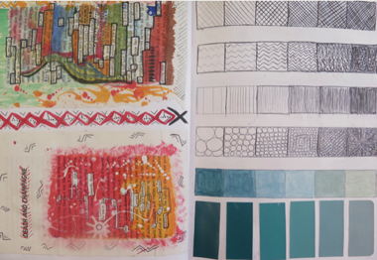
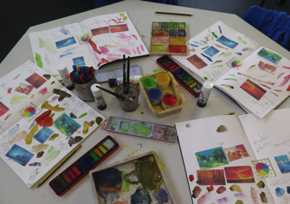
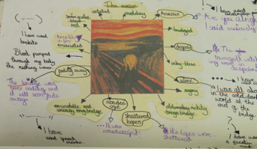
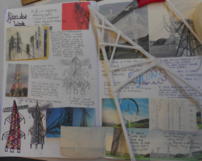
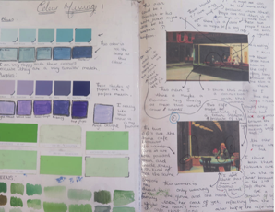
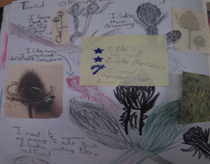
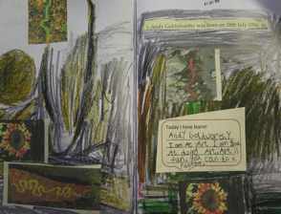
Hundertwasser: Drawing
colour mixing
Printing
pattern
pastels
Courtney Primary School
Sketchbooks @Courtney
I am an Artist @Courtney
…and when I am an Artist anything is possible. I am inspired, excited and challenged by Artists from across the world and the art that I create. My art helps me to express myself, experiment and take risks that challenge me to be creative. As an artist, I feel free to say what I think and be the unique, amazing individual that I am. My art can take me anywhere in the world. It makes me feel happy and relaxed because I am engrossed in my work, which allows me to explore my imagination and the world around me. I know that art can help me understand who I am, other people and the world.
I know that Art is important. It is a form of communication and expression that has existed since pre-history. It tells stories and helps us comment on and understand the world that we live in. It brings joy, creativity and can influence our views and thoughts… it is a language that gives us a deeper insight into what it means to be human.
At Courtney, children will encounter and learn from 3 real artists every school year. Over time they will encounter and revisit drawing, painting, textiles, print and 3D skills. They will develop their own ideas while considering line, colour, shape, form, texture, balance and proportion in different media. There will be an annual exhibition of their work.
Why we use sketchbooks @Courtney
Sketchbooks are a special space where children can freely express, create and develop their art; just as artists do. As artist they use their sketchbook to:
Record observations and gather inspiration.
Explore different art media to experiment.
Develop understanding and record responses.
Review, revisit ideas and make modifications.
Think about and evaluate their art.
When we have embedded the use of sketchbooks in KS2, we will use them across the whole school. Large folders will be provided initially for KS1 and EYFS. The National Curriculum requires sketchbooks to be used in KS2.
Sketchbooks show the learning journey of our artists @Courtney
At Courtney each sketchbook/folder will chart the Art Learning Journey of each child from EYFS to KS3. ‘The learning Journey’ will be stuck on the inside of the front cover of the sketchbook. This will allow us to see the sequence and progression of learning. It will exhibit what they have done before and what they will create next. The Sketchbook will act as evidence that tracks each child’s journey in art throughout their primary education. Assessment ‘milestones’ will also be stuck next to the learning journey with the areas that are to be covered each year. (Teachers to tick as evidence is gathered)
The curriculum of each child’s Art learning journey will investigate 3 artists each year. It is important to note that any art created as a way of enriching other subjects should be evidenced in Topic, English or maths and not in the sketchbook or it can be used as additional evidence in the large class folder provided. Sketchbooks are to be used by pupils as they engage with the Art curriculum and should evidence only the work that is specifically part of that curriculum.
How we use sketchbooks to show our art @Courtney
Sketchbooks should be used to allow children to work as artists and to develop their Art. A sketchbook is not the same as an exercise book it is used in a particular way by artist to develop skills and ideas. Typically drawing will be prioritised in the sketchbooks. it is a place where children can record their ideas, their thinking, their evaluations, their experimentation, as well as their individuality. It typically builds towards a final piece.
Sketchbooks should be exciting to look at, touch and feel, and are central to good practice. As the work is predominantly visual, there are no right or wrong answers. In this subject, children do learn from mistakes and those should be valued as part of the working process. In fact, call it experimentation and ditch the word ‘mistake’!
A large folder per year group will be provided (to keep in each class) for larger or final pieces of work to be stored). This will help to form the evidence base to show progression through the subject; so that pupils know and can do more over time. Names and year group should be recorded on the work. This folder and the sketchbooks will be collected by the subject the leader twice per year for moderation. This will be the end of term 2 and end of term 6.
How we assess our art @Courtney
Assessment- self evaluation, peer assessment and milestones for teachers to tick. It’s not about writing, spelling etc. It is about developing creativity.
Each year has a set of milestones with tick boxes, three areas for each year are in orange and are the priorities to be covered.
A guide to expectations would be to do a couple of pages per artist and a final piece.
A page with a colour copy of the artist’s work and name. (title page) Including annotations, thinking, photos & research. (A bit like the book cover for English when reading a new text)
A page exploring techniques, different media, colours, marks,
A page developing ideas, modifying, gathering inspiration, sketching.
A final piece- In sketchbook or outside of the sketchbook. If outside, a final piece should be evidenced in the large folder with Evaluation/self or peer.
Cultural Capital: is the essential knowledge (and skills) that pupils need to be educated citizens, introducing them to the best the has been thought, (created) and said and helping to engender an appreciation of human creativity and achievement.

